Slide 1
Canada Car Accident 1999 - 2014
Boris Korotkov
Chaewon Kim
Patricia Luo
Ryan He

Slide 2
Canada Car Accident 1999 - 2014
Overview
Analysis and Conclusions

Slide 3
Data Source
Canada, 1999 – 2014, CSV from Kaggle
Collision data: Date, Time, Severity, Road condition, Weather, etc.
Vehicle data: Type, Model year
Person data: Sex, Age, Position, Treatment, Safety device, etc.
C_YEAR | C_MNTH | C_WDAY | C_HOUR | C_SEV | C_VEHS | C_CONF | C_RCFG | C_WTHR | C_RSUR | C_RALN | C_TRAF | V_ID | V_TYPE | V_YEAR | P_ID | P_SEX | P_AGE | P_PSN | P_ISEV | P_SAFE | P_USER
1999 | 1 | 1 | 20 | 2 | 2 | 34 | UU | 1 | 5 | 3 | 3 | 1 | 6 | 1990 | 1 | M | 41 | 11 | 1 | UU | 1
About 6 million registered collisions
Most are number in string
Special values: e.g., not applicable, unknown

Slide 4
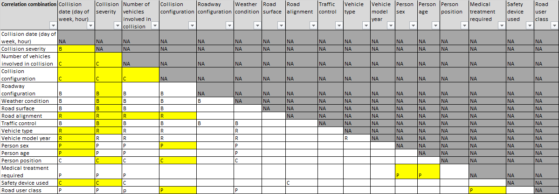
Data Loading & Preparation
Load data through pandas.read_csv, all cleanup/analysis in Python
Team analyzed all fields, each analysis covers relationship of two

Slide 5
Canada Car Accident 1999 - 2014
Overview
Analysis and Conclusions

Slide 6
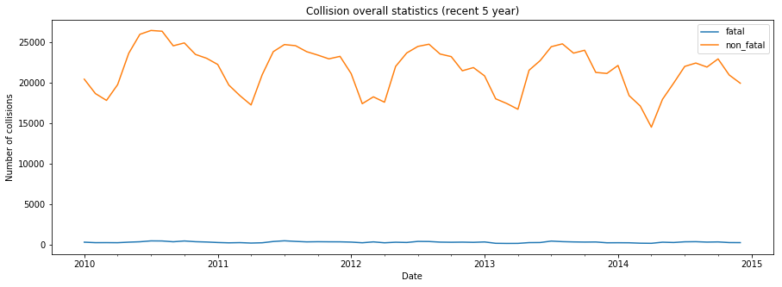
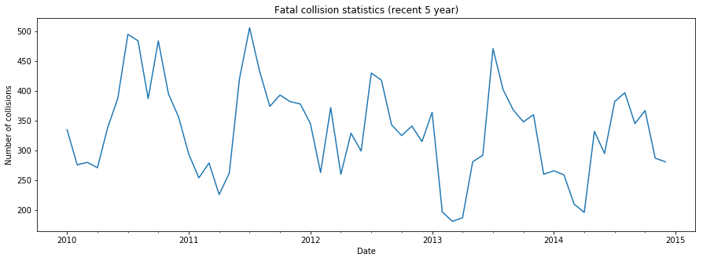
1. Fatal and Non-fatal Collision

Slide 7
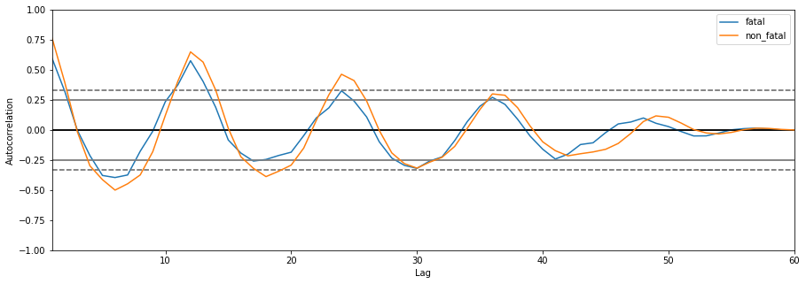
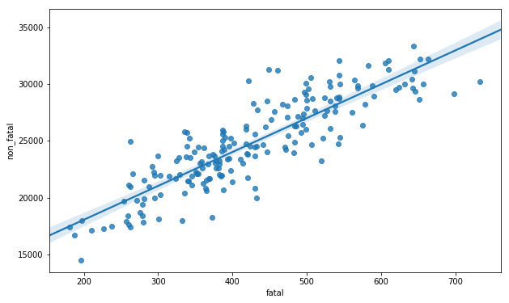
1. Fatal and Non-fatal Collision (cont’)
The autocorrelation of fatal and non-fatal collisions both follow similar pattern, which is a seasonal cycle of a year.
The distribution of fatal and non-fatal collisions are highly linear correlated.

Slide 8
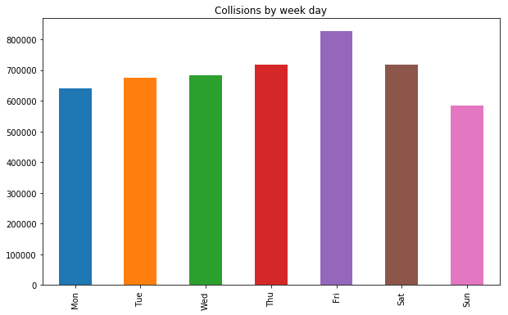
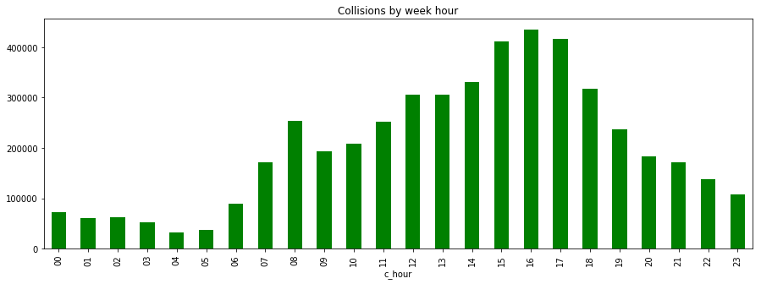
2. Collision Distribution by Week Day and Hour
Day Hour
Week Day

Slide 9
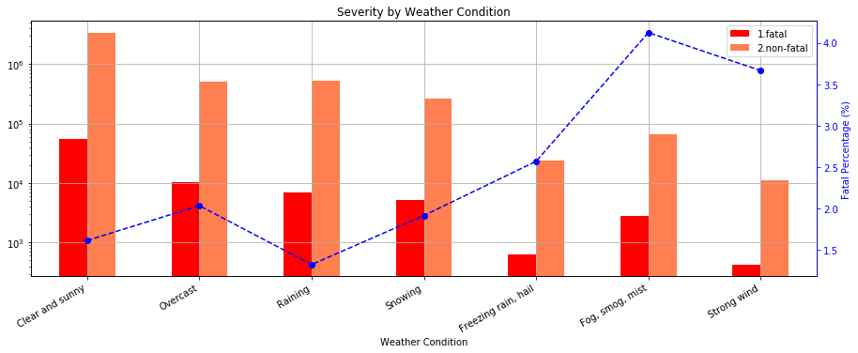
3. Weather and Collision Severity
The majority of collisions had place in a clear and sunny day.
The most dangerous weather for drivers was weather with limited visibility like as fog, smog and mist and weather with strong wind.

Slide 10
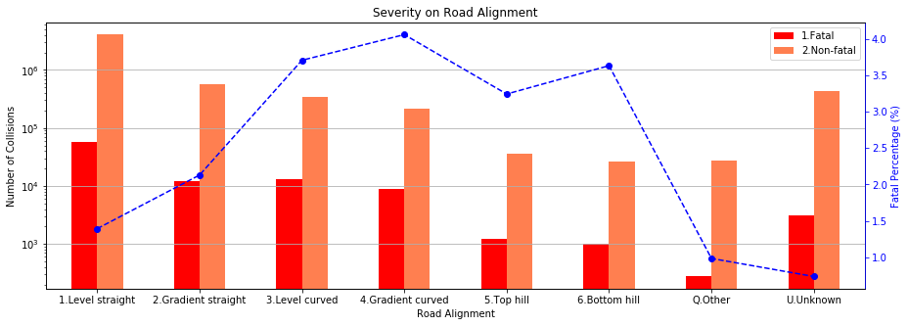
4. Road Alignment and Collision Severity
Most collisions happened in level and aligned road. However, bad road alignment may post higher risk of fatal accident.

Slide 11
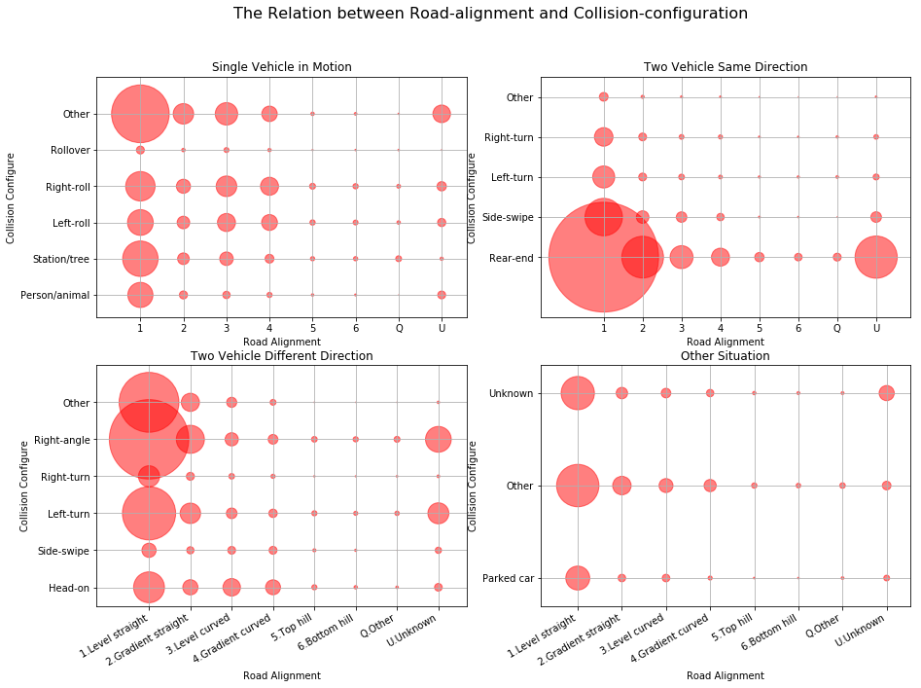
5. Road Alignment and Collision Configuration
Rear-end collision is the most popular collision type. Right-angle collision and left-turn collision are also popular

Slide 12
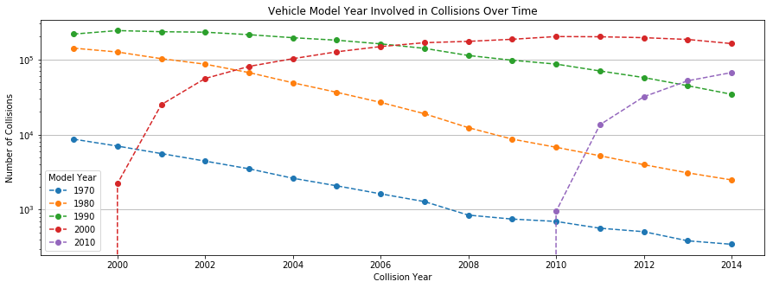
6. Vehicle Model Year Involved in Collision
As the collision rate peaks in a vehicle model’s 10th year

Slide 13
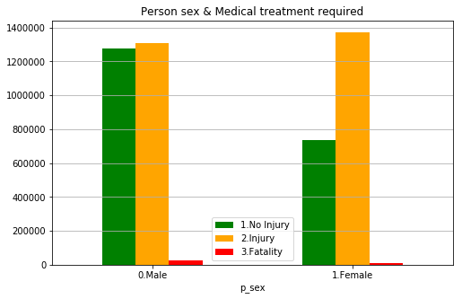
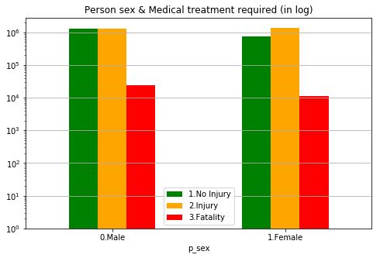
7. Person Sex
Female is more likely to injure in an accident. However, men are more likely being involved in a fatal accident.

Slide 14
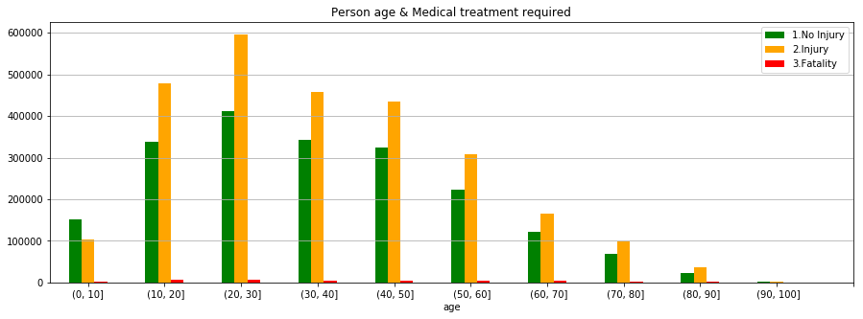
8. Person Age
The most dangerous population is from 21 to 30 years old, called young adults, and the in-accident probabilities decreases with age increases.

Slide 15
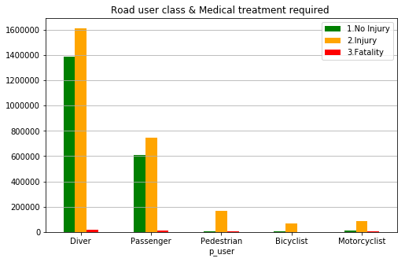
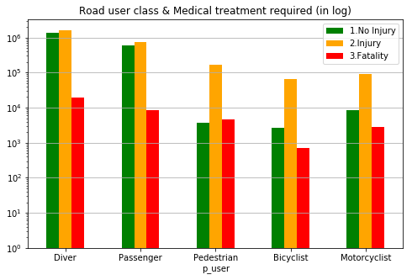
9. Road User Class
The major road user class involved in an accident is drivers, they are twice likely to get hurt or die than passengers.
Bicyclists are the safest, because of the lowest injuries and deaths.

Slide 16
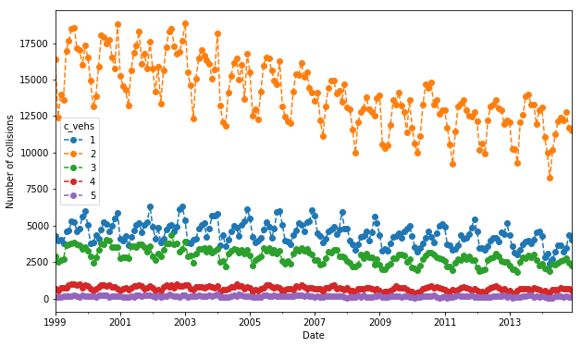
10. Number of Vehicles Involved in Collision
The most frequent number of vehicles involved in collisions over week day was 2 vehicles followed by 1 and 3 vehicles involved in collisions.

Slide 17
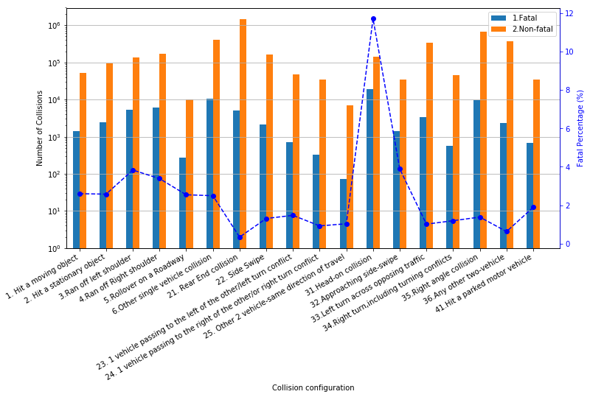
11. Collision Configuration and Severity
Rear-end collision is the most common type of collision, but the lowest fatal rate.
Even though the head-on collision is an unusual collision configuration; however, it is deadly.

Slide 18
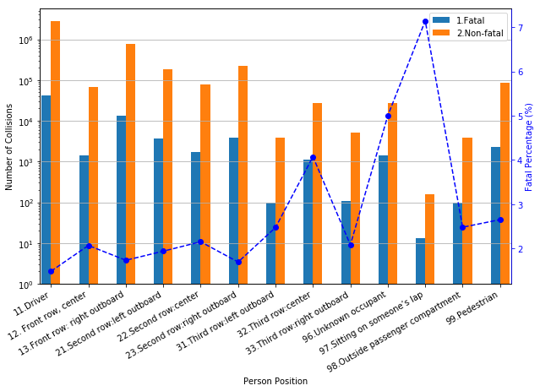
12. Person Position and Collision Severity
Driver is more likely to involved in an accident. Spuriously, the fatal rate is the lowest.
The highest fatal rate is the person, like baby, who is sitting on other’s lap when a traffic happens.

Slide 19

Canada Car Accident 1999 - 2014

Slide 20
Canada Car Accident 1999 - 2014
Thank You

